Slide 2
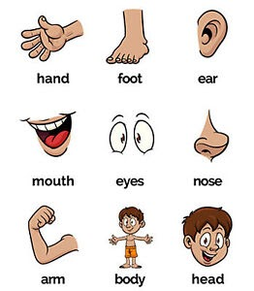
Parts of the body

Slide 4
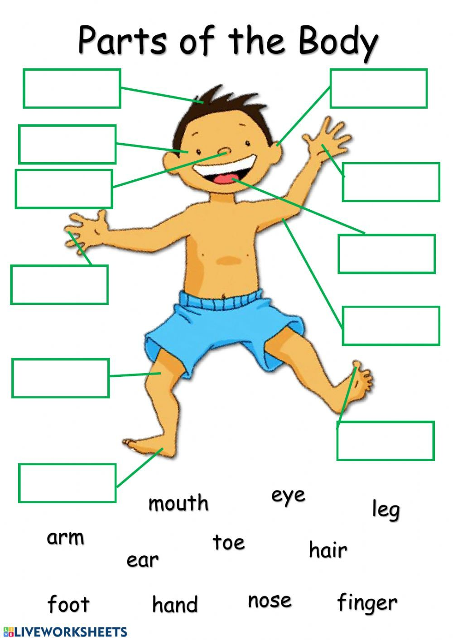
Label the parts of body
Try labelling each part here to see if you know all the parts of the body

Slide 5
LET’S PLAY A GAME “Touch Your Nose, Please”
*If you hear PLEASE, you FOLLOW MY INSTRUCTIONS.
*If I didn’t say PLEASE, don’t do anything

Slide 6
Describe yourself using
HAVE GOT and words
Big/small
Brown/blue/green/yellow/black

Slide 7
I have got blue eyes=
I’ve got blue eyes
I’ve got a small nose

